Slide 1

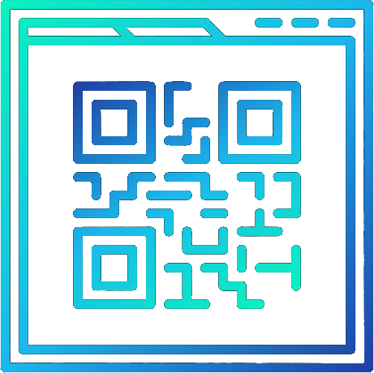
ElastiQR
Logan O'Neal, Caleb Fisher, Eric Vaughan, Jacob King, & Hayden Curl

Slide 2
Tech Stack
Frontend:
React, JavaScript, Material UI
Backend:
NodeJS, Express
Database:
MySQL, GCP Cloud SQL

Slide 3
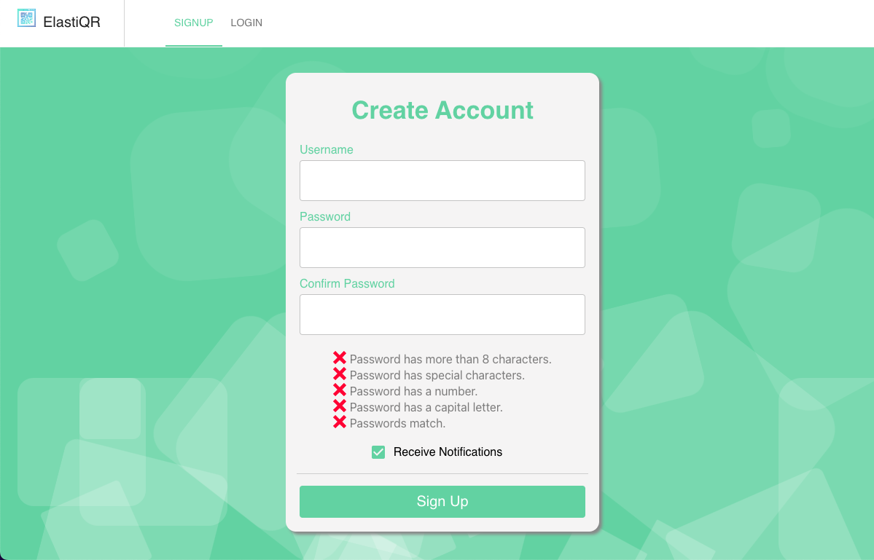
Sign In Page
Only info needed to create an account is a username and password
Password requirements to improve security

Slide 4
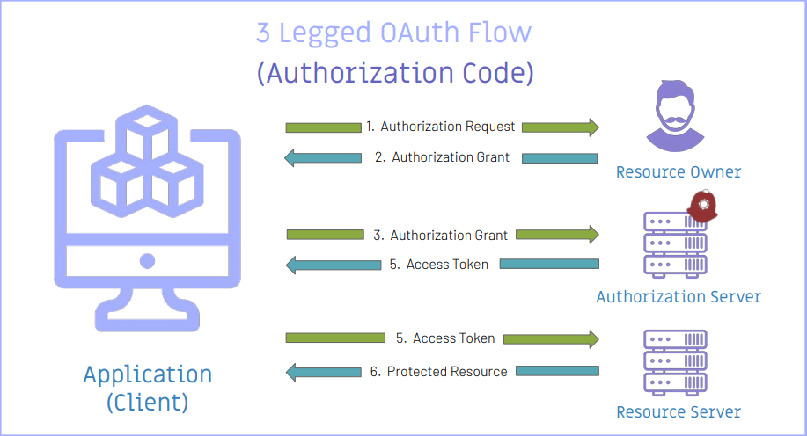
OAuth CLI
An authorization code is sent back to the client on successful login.
The authorization code is then sent to our backend server to validate the code and return an access token (JWT).
This access token can be used to access protected resources such as our bulk QR management service.

Slide 5
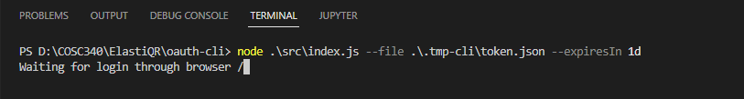
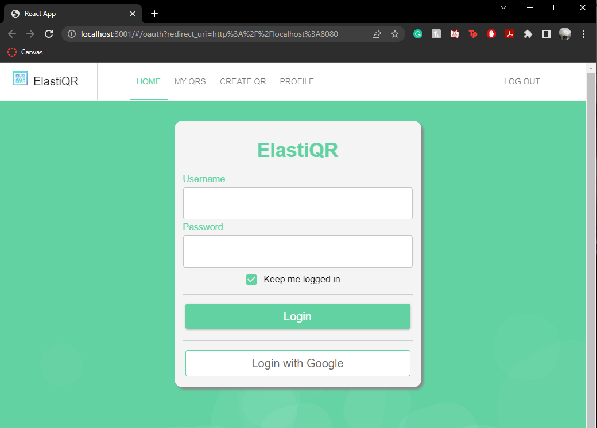
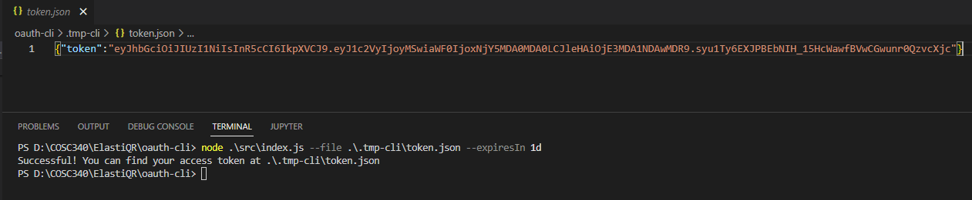
OAuth CLI

Slide 6
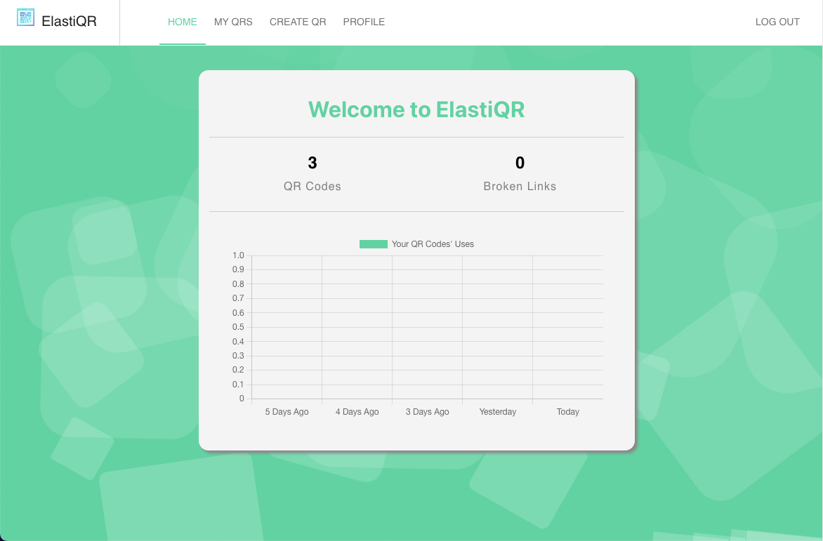
Home Page

Slide 7
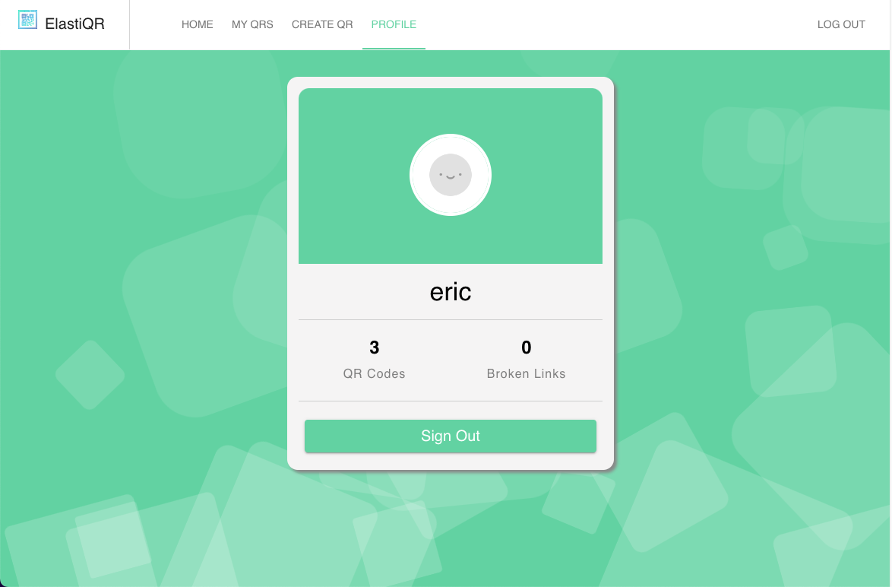
Profile Page

Slide 8
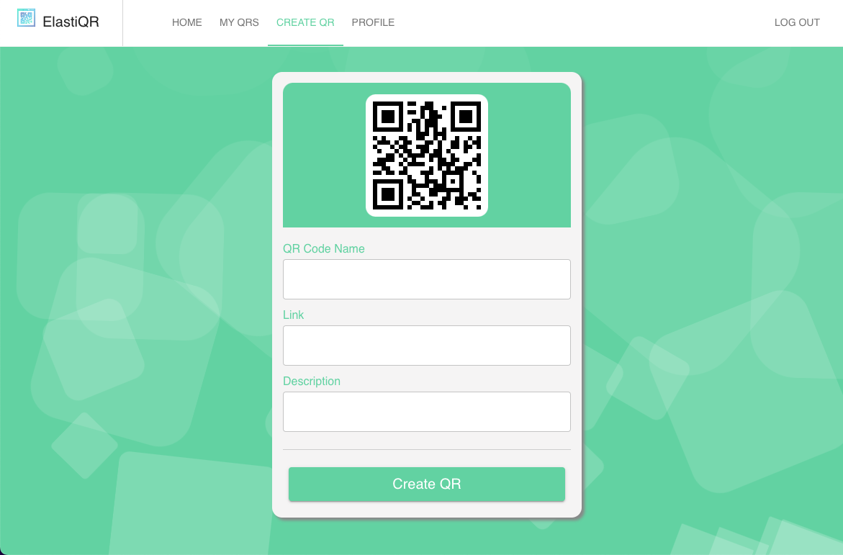
QR Code Creation Page
Add a link and provide a name
The description is optional

Slide 9
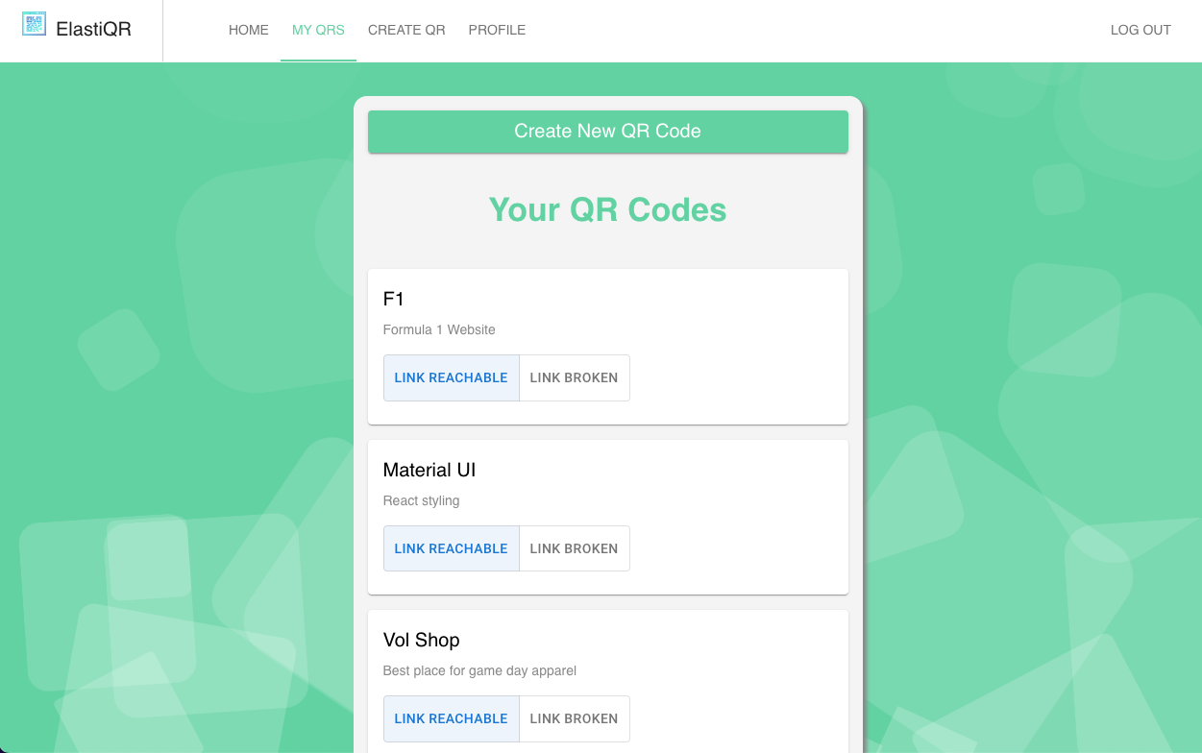
QR Codes List
For each QR code the following is shown:
Name
Description
Whether the QR code is working

Slide 10
QR Validation Service
Runs every 15 minutes
Check every QR link for broken endpoints and alerts the user to issues using the QR list.
User homepage keeps track of total broken links

Slide 11
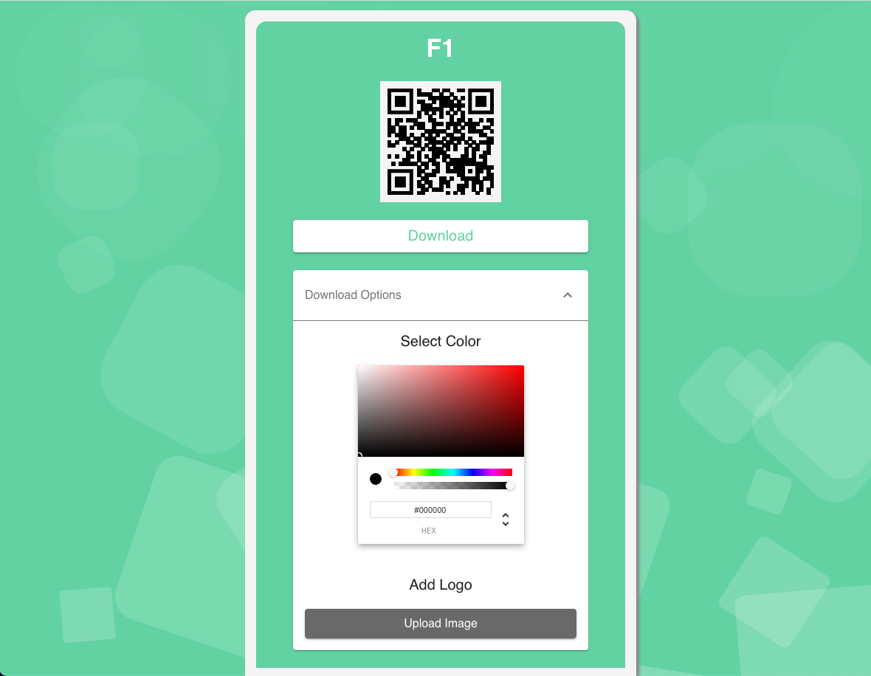
Details Page: Download & Customization
Downloads QR Code as a PNG file
Download customization options:
Specify color
Add a logo

Slide 12
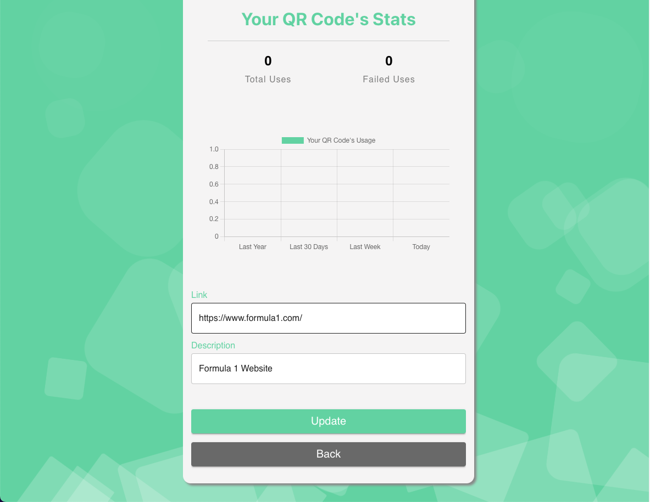
Details Page: QR Code Information
Displays the link, description, and usage stats
Can update the link and description

